Slide 1
Sentiment analysis using Tala app reviews

Slide 2
Introduction
Sentiment is an attitude, thought, or judgment prompted by feeling. Sentiment analysis is used to determine whether a given text contains negative, positive, or neutral emotions.
Sentiment analysis can help you understand how people feel about your product at scale.
Data used in this study are online loan product reviews collected from Tala.com through web scrapping from google play store.

Slide 3
Why sentiment analysis?
More trustworthy -Removes human bias through consistent analysis
More powerful - Processes data at scale. Sentiment analysis helps businesses make sense of huge quantities of unstructured data.
Save time - Automation! Sentiment analysis algorithms can analyse hundreds of megabytes of text in minutes. Sentiment analysis algorithms and approaches are continually getting better. They are improved by feeding better quality and more varied training data.
Act faster: Real-time analysis and insights. Sentiment analysis is automated using Machine Learning. This means that businesses can get insights in real-time. This can be very helpful when identifying issues that need to be addressed right away

Slide 4
Justification of the study
Great customer service experience can make or break a company. Customers want to know that their query will be dealt with quickly, efficiently, and professionally. Sentiment analysis can help companies streamline and enhance their customer service experience.
Sentiment analysis can identify how your customers feel about the features and benefits of your products. This can help uncover areas for improvement that you may not have been aware of.

Slide 5
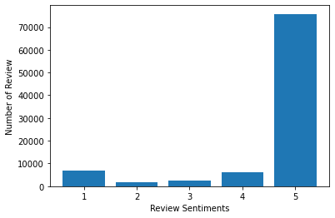
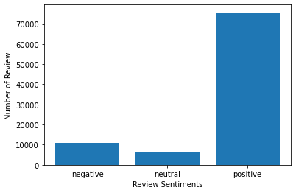
Research design and methodology
70000+ people gave a 5 star review for the tala app
Data collection: Data used is a set of Tala loan app reviews collected through web scrapping from google play store.
Every rating score is based on a 5-star scale.
We’ll categorize reviews into three categories:
negative: ratings below 3
neutral: ratings equal to 3
positive: ratings above 3
 | score | thumbsUpCount
count | 92933 | 92933
mean | 4.533417 | 3.452326
std | 1.134479 | 54.161168

Slide 6
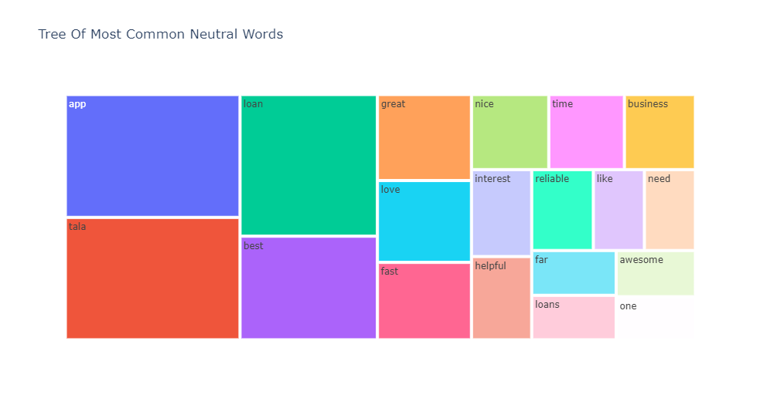
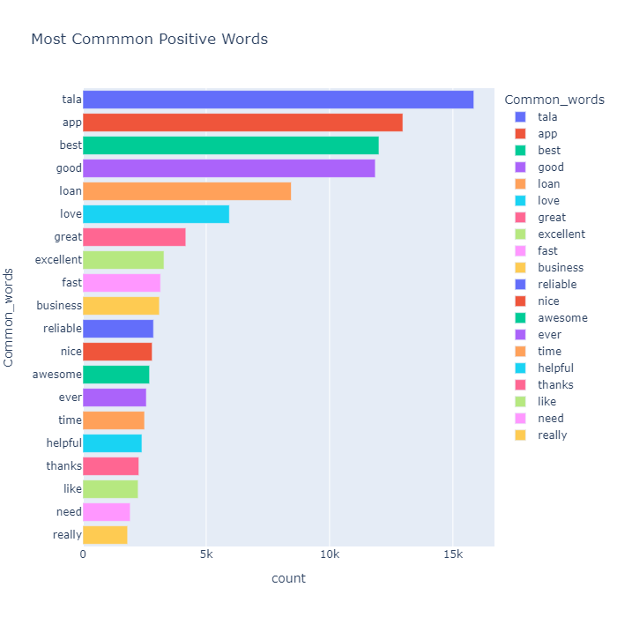
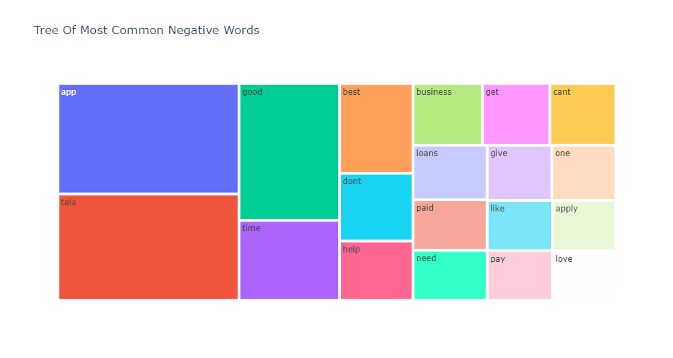
Sentiment analysis
Data processing: stop words are removed and tokenization is carried out for the model to understand.
We have words like great, good, like, love etc which are in negative and neutral categories hence we evaluate the polarity of the reviews for better understanding.

Slide 7
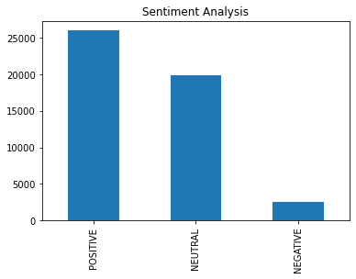
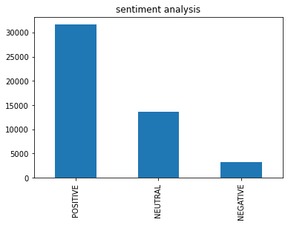
Sentiment polarity categorization
Results from using textblob
Text blob sentiment analyser returns two properties for a given input sentence:
Polarity is a float that lies between [-1,1], -1 indicates negative sentiment and +1 indicates positive sentiments.
Subjectivity is also a float that lies in the range of [0,1]. Subjective sentences generally refer to opinion, emotion, or judgment
Vader It uses a list of lexical features (e.g. word) which are labelled as positive or negative according to their semantic orientation to calculate the text sentiment. Vader sentiment returns the probability of a given input sentence to be positive, negative, and neutral.
Results from using Vader

Slide 8
Modelling
LSTM stands for Long Short Term Memory Networks. It is a variant of Recurrent Neural Networks. Recurrent Neural Networks are usually used with sequential data such as text and audio.
The architecture of our model consists of an embedding layer, an LSTM layer, and a Dense layer at the end. To avoid overfitting, we introduced the Dropout mechanism in-between the LSTM layers.

Slide 9
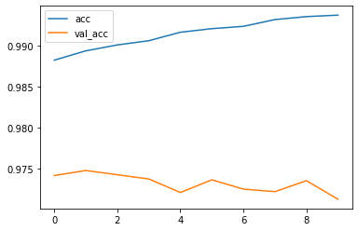
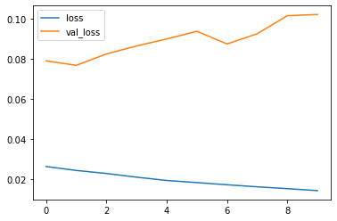
Model evaluation
The LSTM sentiment analysis model obtained 99.37% accuracy on the training set and 97.12% accuracy on the test set.
It also obtained 1.44% loss on the training set and 10.2% loss on test set

Slide 10
Conclusion
Sentiment analysis indicates the results into positive negative and neutral scores. Its most significant advantage is the introduction of the possibility to use direct user feedback with minimal human supervision while still being able to scale up easily.
This paper tackles a fundamental problem of sentiment analysis, sentiment polarity categorization we used both textblob and Vader
We obtained more than 97% accuracy on validation using the LSTM neural network model.

Slide 11
Recommendation
Further research can be carried out by leveraging multilingual pre trained models for language translation.

